Slide 1


PRICE COMPARISON WEBSITE
SURIYA . J ( 211061101458 )
SIVA . K( 211061101429 )
SUBAN. S( 211061101440 )

Slide 2
Introduction
Price comparison website allows consumers to see different lists of prices for the product chosen by user and it helps consumers to make an informed decision about which to choose in order to save money.
It also act as a tool to help consumers increase their price consciousness so that they will not feel cheated by the advertisement from the retailers that claimed they are offering the cheapest price but the reality happened to be otherwise.
A price comparison website act as the medium between customers and retailers so customers can make purchase online for certain retailers that provide such services.
Besides, users nowadays are very comfortable with the internet that it has grown a wider variety of applications from networking and now provide various references for the users.

Slide 3

Abstract
A price comparison website provides platform for customers to check on the price of the products and sellers will be able to promote their products online. This project, named as PriceWar.com is the place where shoppers could find the great deals on the home groceries products where the results are sorted from the cheapest price onwards.
The website will be beneficial towards the sellers/retailers as well because they will be able to advertise their products and promote their shops at the same time. Unlike the giant supermarkets that have their own website, most of the owners of small groceries shop do not have the skills to have their own website or blog to promote their business online.
Thus, with this website, the chances are open for the interested groceries shop owners to advertise their products in the website for free. They just need to provide the price information regularly and the admin of the website will do the rest.

Slide 4
Objectives
The objective of this project is to develop a price comparison website that will have the following functions:
To provide customers with a list of price comparison and highlight the cheapest price specifically in home groceries products .
To increase price consciousness among consumers.
To ensure that the price database is updated regularly so that customers will be able to get accurate results.
To provide service for users to find the product’s price.
To provide platform for retailers to promote their products and promotion for free

Slide 5

Problem Statement
It is important for a web comparison website to return results with the low prices as what the customers want but accurate results also important so that customers can get what they really want.
It also depends on how regular the database is being updated otherwise customers will be confused when they compared it from other site.
Most of the working people do not have time to do shopping for their home groceries. As consumers, they have the right to choose which shop is offering the best price for a certain products that they are interested in.
However, to check on price offered by each shop is time consuming and due to limited time that they have, they are not able to compare the prices and end up buying certain product with higher price.

Slide 6
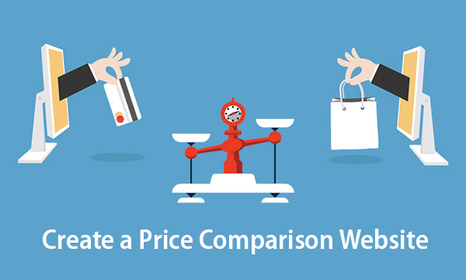

Slide 7
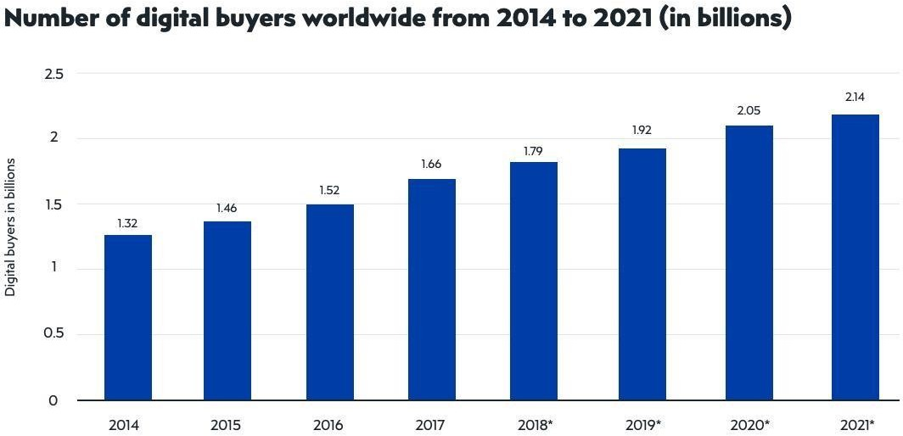

Slide 8
Literature Survey
The research was focus on the price comparison sites and its connotation towards market efficiency and price competition
The price comparison sites attract all the involved parties no matter suppliers or the consumers to its platform as it has become the aggregator of product information.
Nowadays people usually conduct first research on the internet regarding a particular product or service that they want which is very convenient as compared to what consumers have to do previously when there is no internet.

Slide 9
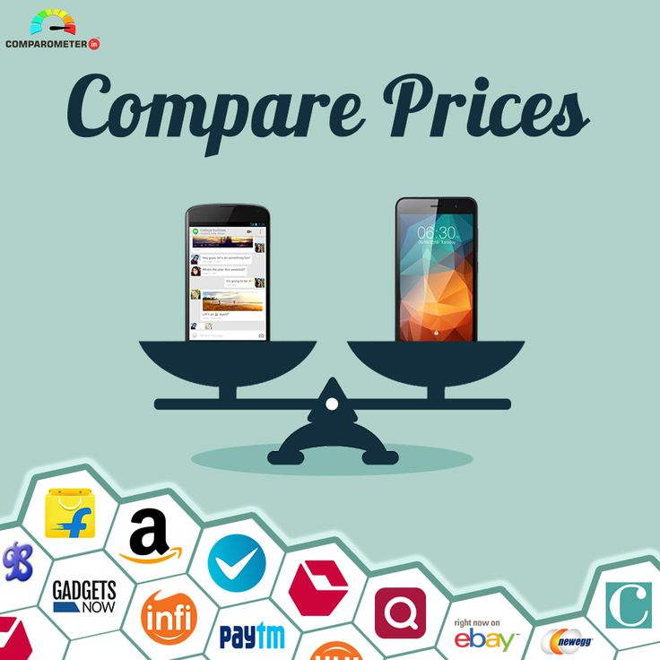

Slide 10
Existing System
The main objective of doing research on similar existing system is to know how it works, what concept is being applied in the system, what is being computed by the system and how the system helps solving the problem.
After the research on similar existing systems, the next step needed is to identify what will be the main component that made up the system to be developed.
In order for the visitors of this website to use it services, they have to register with their basic information such as name, email, etc.
Database to store products and users’ information.
User able to search the product that they are interested.

Slide 11
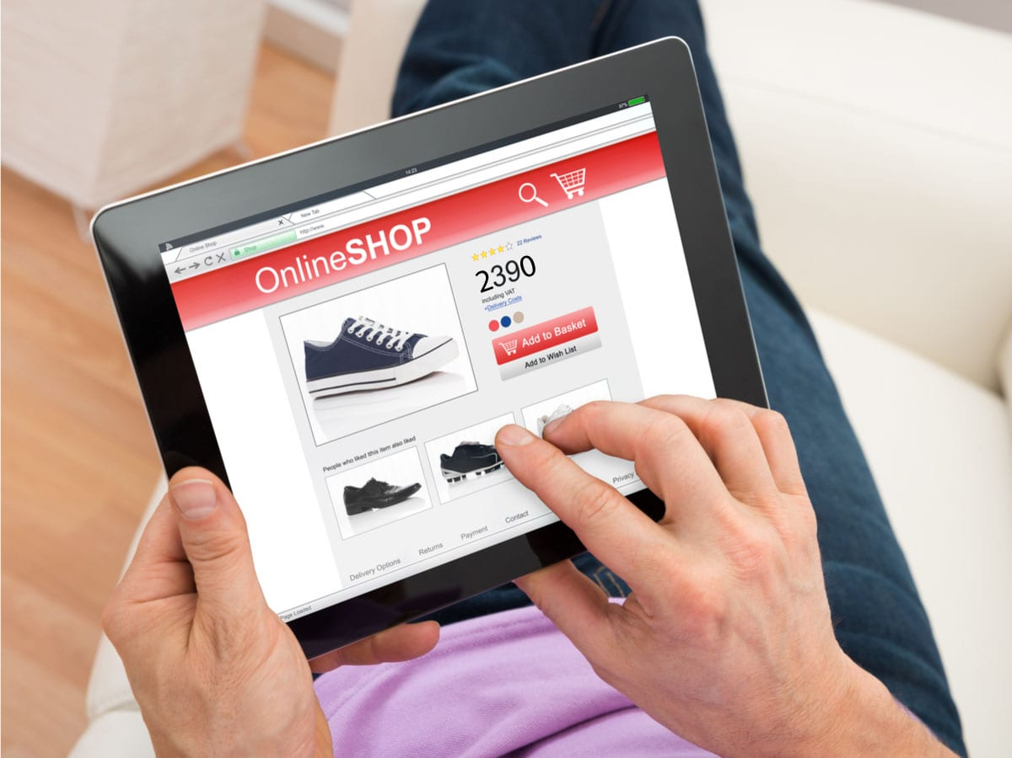
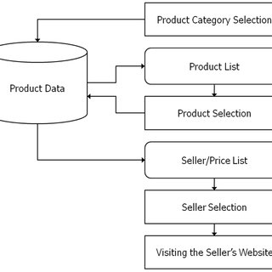
FLOW CHART:

Slide 12

Proposed System
This will give the clear picture and understanding on how the system will operate and to avoid developing a system that does not solving the problem it intended to solve.
Registered Users :
The website requires visitors to sign up before they can use the functions in the website. The registered users will have personal account to this website and they may login using their username and password. The actions that registered users can do with this websites are;
Login to the website
Able to edit profile
Newsletter subscription
Search groceries products
View promotion and sales
Compare prices

Slide 13


